Slide 1
Food Waste Prediction
Luis Gonzalez Guzman
luis.gonzalez@wizeline.com

Slide 2





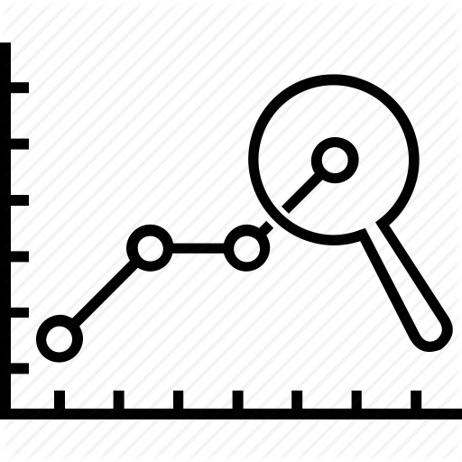
App flow
Data collection
Preprocessing
Dataset creation
Model creation
Prediction
TRAINING DATA
Raw
registers
Registers
Group and count
registers by diet
Training data
Build model
Evaluate
Raw
menus
Menus
Build BoW and
extract features
TEST DATA
Raw
Menus
Extract features
(BoW)
Test data
Use prediction
Use model
Raw
registers
Group and count
registers by diet

Slide 3
App modules
Data collection module
Preprocessing module
Prediction module
TRAINING DATA
Raw
registers
Registers
Group and count
registers by diet
Training data
Build model
Evaluate
Raw
menus
Menus
Build BoW and
extract features
TEST DATA
Raw
Menus
Extract features
(BoW)
Test data
Use prediction
Use model
Raw
registers
Group and count
registers by diet

Slide 4

Training data
Breakfast
Date | 2020-02-10
Day | monday
Service | true
Regular | Ham and cheese ....
Light | Scrabled egg ...
Vegan | Vegan bagel ...
Vegetarian | 3 cheese bagel ...
Extract
Raw
menus
Lunch
Breakfast
Date | 2020-02-10
Person | Luis Gonzalez Guzman
Diet | Regular
Request | true
Attend | false
Extract
Raw
registers
Lunch

Slide 5
Test data
Breakfast
Date | 2020-02-10
Day | monday
Service | true
Regular | Ham and cheese ....
Light | Scrabled egg ...
Vegan | Vegan bagel ...
Vegetarian | 3 cheese bagel ...
Extract
Raw
menus
Lunch
Breakfast
Date | 2020-02-10
Person | Luis Gonzalez Guzman
Diet | Regular
Request | true
Extract
Raw
registers
Lunch

Slide 6
Preprocessing: Grouping registers
Date | Person | Diet | Request | Attend
2020-01-02 | Luis G.... | Regular | true | false
2020-01-02 | Juan S .... | Regular | false | false
.... | ... | ... | ... | ...
2020-01-03 | Luis G... | Vegan | true | true
... | ... | ... | ... | ...
Group registers
Grouped by same
date and diet
Count records
on the same date
Count requests
equal to true
Count same diet
requests
Count people
who attend
Request - Attend
Date | Diet | TotalPeople | TotalRequests | Request | Attend | Difference
2020-01-02 | Regular | 364 | 235 | 78 | 63 | 15
2020-01-02 | Light | 364 | 235 | 26 | 12 | 14
2020-01-02 | Vegan | 364 | 235 | 7 | 3 | 4
2020-01-02 | Vegetarian | 364 | 235 | 18 | 10 | 8
2020-01-03 | Regular | 370 | 205 | 62 | 46 | 16
... | ... | ... | ... | ... | ... | ...

Slide 7
Preprocessing: Build Bag of Words
Date | Day | Service | Regular | Light | Vegan | Vegetarian
2020-01-02 | thursday | true | ham and cheese bagel (1pc) | scrambled egg whites with ham | vegan bagel veggies with hummus | scrambled eggs with bellpeppers
2020-01-03 | friday | true | scrambled eggs with ham | scrambled egg whites | vegan sweet crepes (2pcs) | scrambled eggs mexican style
... | ... | ... | ... | ... | ... | ...
Clean text and build a Bag of Words model from diets columns
Features (1xN) :
[ bagel , bean , burrito , egg , piece , scrambled , ham , ...]
Example: Regular (2020-01-02)
ham and cheese bagel (1pc)
ham cheese bagel 1 piece
[ 1 , 0 , 0 , 0 , 1 , 0 , 1 , .... ]
Raw menu
Cleaned menu
BoW vector

Slide 8
Merge data
Joining Registers and Menus datasets by date,
droping the date column and keeping the service day records
Menu
Records
bagel | bean | burrito | .... | Day | Diet | TotalPeople | TotalRequests | Request | Attend
0 | 2 | 1 | ... | tuesday | Regular | 364 | 235 | 78 | 63
1 | 0 | 0 | ... | wednesday | Light | 364 | 235 | 26 | 12
0 | 0 | 2 | ... | thursday | Vegan | 364 | 235 | 7 | 3
0 | 1 | 1 | ... | friday | Vegetarian | 364 | 235 | 18 | 10
2 | 2 | 0 | ... | monday | Regular | 370 | 205 | 62 | 46
1 | 0 | 3 | ... | ... | ... | ... | ... | ... | ...
Features (N-Columns )
To predict

